Slide 1


The Art of Design Patterns
2023
Refactoring & Clean Code I
Prepared By:
Tasneem Bahaa & Mahmoud Mohamed
Notes:
Greetings , welcome to the Art of design patterns + Who am I?

Slide 2
Agenda
Clean code concepts:
Technical Debt
Code Smells
Refactoring
Change Preventers

Slide 3
Clean Code
Clean code is obvious for other programmers.
Clean code doesn’t contain duplication.
Clean code contains a minimal number of classes and other moving parts without violating single responsibility
Clean code passes all tests.
Clean code is easier and cheaper to maintain!
Notes:
Usually deals with constructors, object creation

Slide 4
Naming
Choose Descriptive / Unambiguous Names
Choose Names at Appropriate Level of Abstraction
Name Interfaces After Functionality They Abstract
Name Classes After How They Implement Interfaces
Name Methods After What They Do
Use Long Names for Long Scopes
Names Describe Side Effects
Standard Nomenclature Where Possible
Encodings in Names

Slide 5

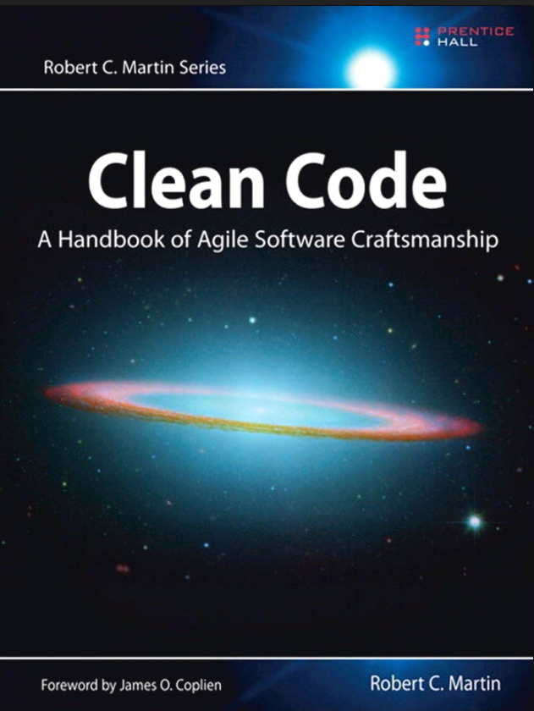
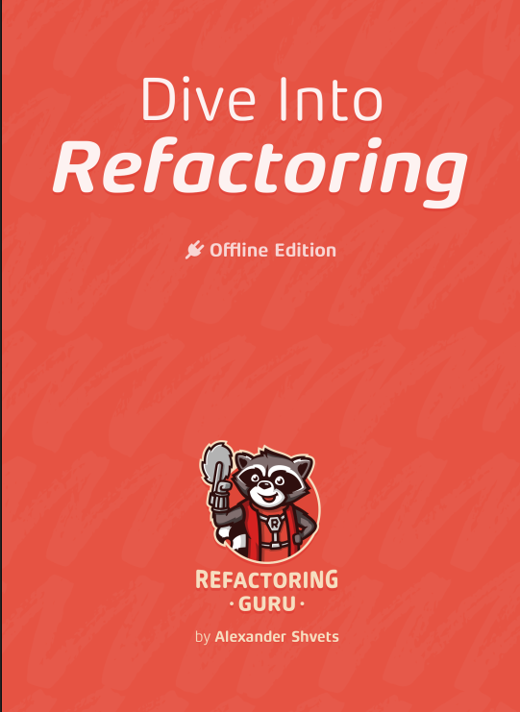

Resources
Recommended Books:
* Ordered by easiest to more advanced
Dive into Refactoring
Clean Code: A Handbook of Agile Software Craftsmanship
Refactoring: Improving the design of existing code
Recommended Websites:
https://refactoring.guru

Slide 6
Technical debt
What is technical debt?
Technical debt -- or tech debt -- is the implied cost incurred when businesses do not fix problems that will affect them in the future. Accruing technical debt causes existing problems to get worse over time. The longer debt builds up, the more costly it becomes to rectify.
Notes:
Usually deals with constructors, object creation

Slide 7
Technical debt
What is technical debt?
Technical debt -- or tech debt -- is the implied cost incurred when businesses do not fix problems that will affect them in the future. Accruing technical debt causes existing problems to get worse over time. The longer debt builds up, the more costly it becomes to rectify.
"build now, fix later"
Notes:
Usually deals with constructors, object creation

Slide 8
Why is technical debt important 🤔?
As technical debt accumulates, the teams become less capable of focusing on growth and new features and become more concerned with putting out fires -- implementing short-term solutions to longstanding, worsening core problems.

Slide 9
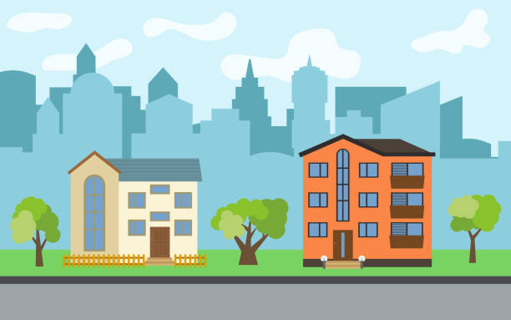

Slide 10
Why ?
Unclear project requirements. If teams alter or redefine requirements well into the project, it can force them to go back into the code and rework it to include new components that conform to the new requirements.
Bad code. Code without proper standards can make updating it later increasingly difficult. Nonmodular code can make it harder to integrate with other code further down the line.

Slide 11
Lack of documentation. Missing or inaccurate code documentation can make revisiting or updating code difficult, as programmers are forced to reacquaint themselves with the codebase.
Lack of testing. Releasing code without testing it can cause technical debt in the form of performance errors that require patches or fixes.
Ignoring updates. Letting legacy code or systems sit while new ones are implemented can lead to interoperability issues down the line.

Slide 12
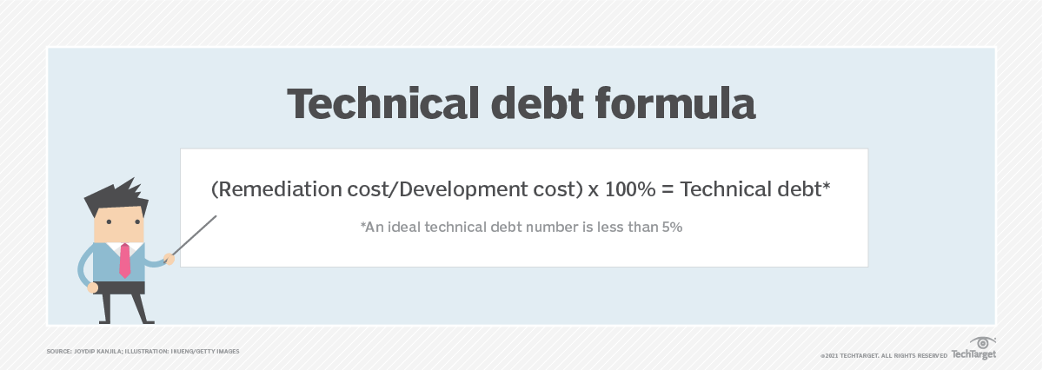
Technical dept ratio

Slide 13
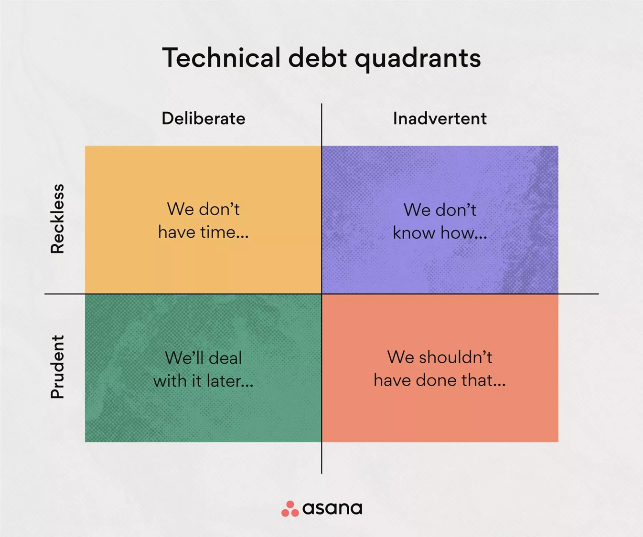

Slide 14
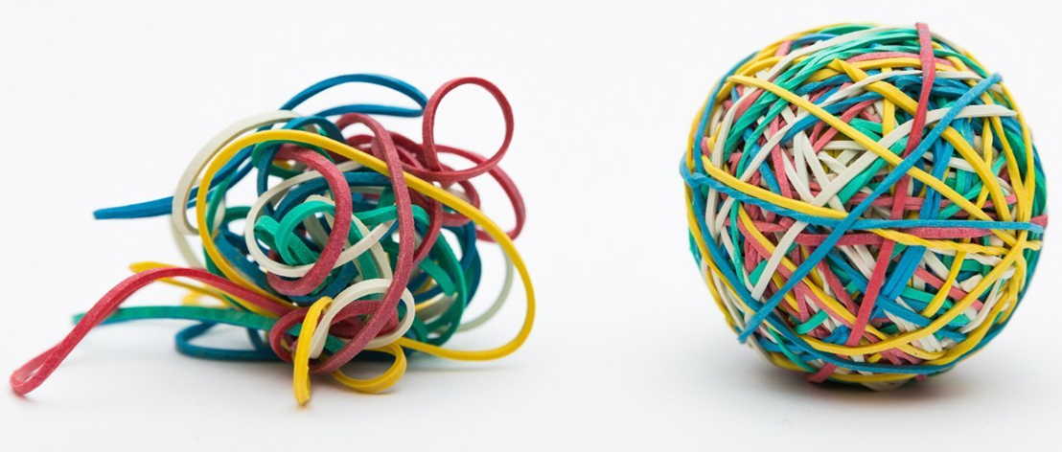
Refactoring
Refactoring or Code Refactoring is defined as systematic process of improving existing computer code, without adding new functionality or changing external behavior of the code.

Slide 15
When to refactor 🕐
1- Rule of Three
When you’re doing something for the first time, just get it done.
When you’re doing something similar for the second time, cringe at having to repeat but do the same thing anyway.
When you’re doing something for the third time, start refactoring.

Slide 16
2 - When fixing a bug 🐛
3 - When adding a feature ✅
4 - During a code review 🔎

Slide 17

How to refactor
Checklist of refactoring done right way
All existing tests must pass after refactoring.
The code should become cleaner.
New functionality shouldn’t be created during refactoring.

Slide 18
How to identify code to refactor?

Slide 19
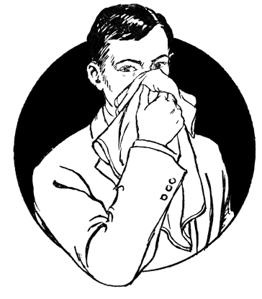
How to identify code to refactor?
Code smells

Slide 20
Code smells are not bugs or errors. Instead, these are absolute violations of the fundamentals of developing software that decrease the quality of code.

Slide 21
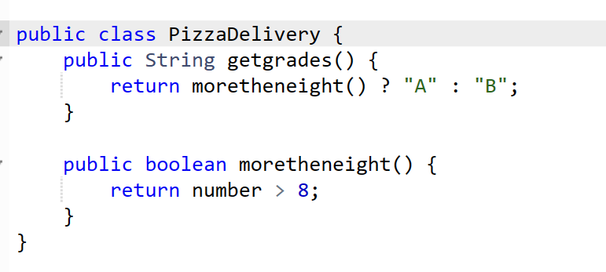
Inline Method – When we have a method body which is more obvious than the method itself. Example :

Slide 22

Inline Method – When we have a method body which is more obvious than the method itself. Example :

Slide 23
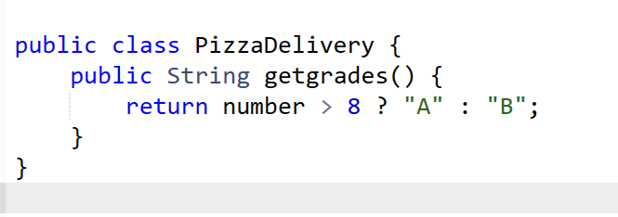
Inline Method – When we have a method body which is more obvious than the method itself. Example :

Slide 24
Extract Method – When we have a code that can be grouped together.

Slide 25
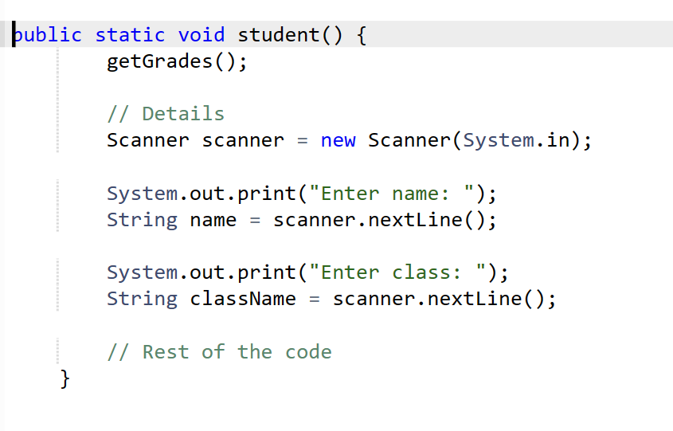

Slide 27
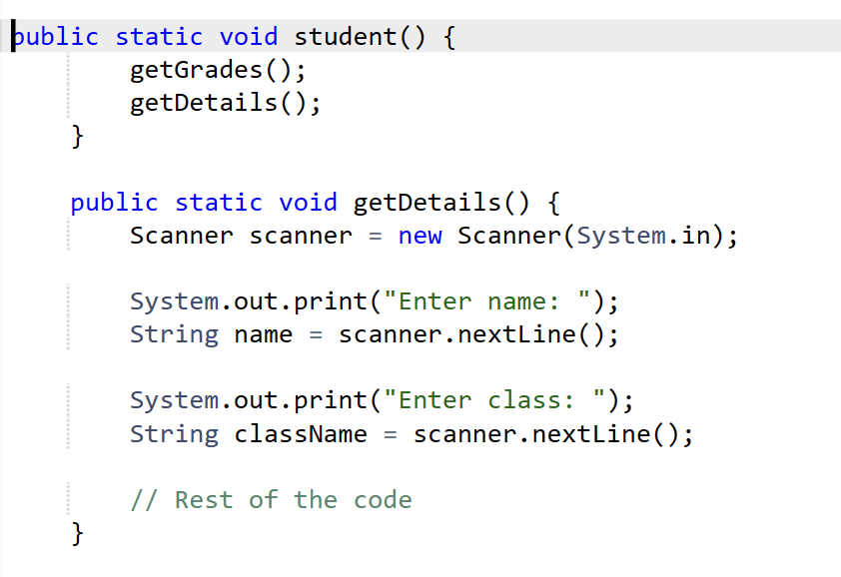

Slide 28
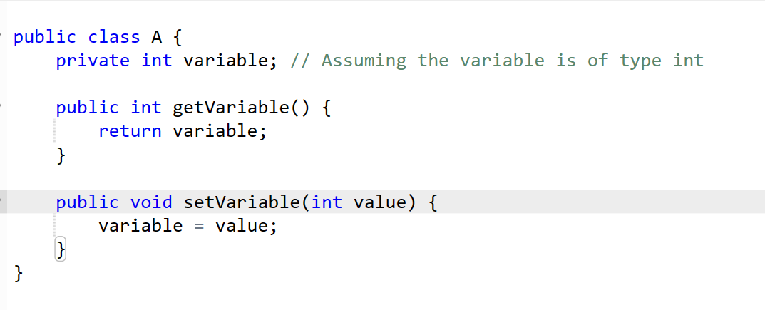
Encapsulate Field – It involves providing methods that is used to read/write data rather than accessing it directly. Example :

Slide 29
Replace Conditional with Polymorphism – When we have a conditional that performs various actions depending on object type or properties. Example

Slide 30
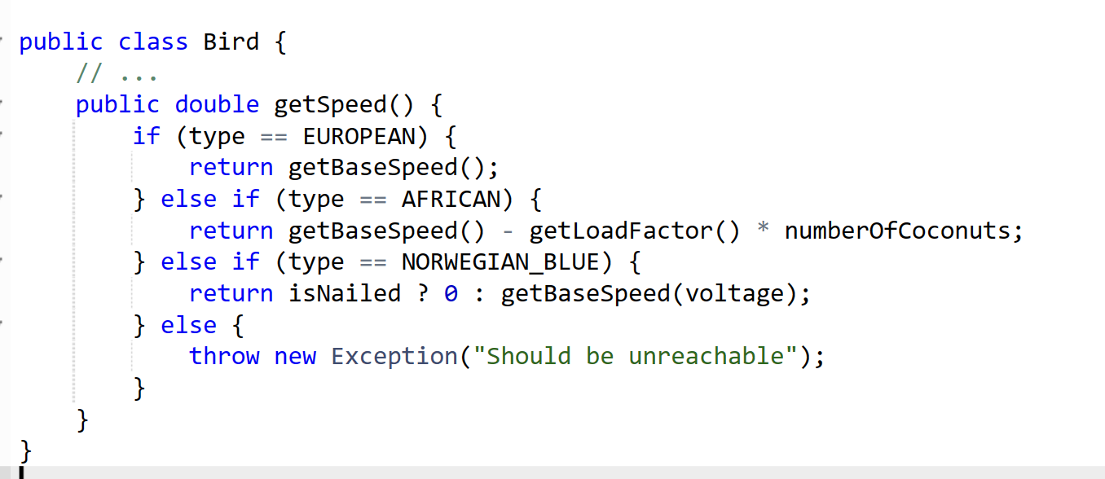

Slide 32
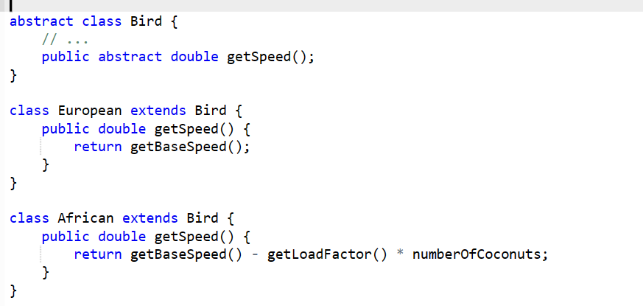
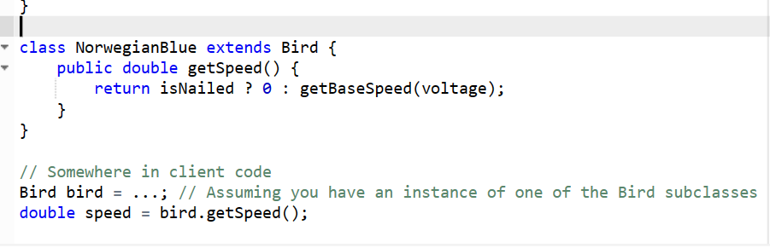

Slide 33
Refactoring improves the design of software.
Refactoring makes software easier to understand.
Refactoring helps us finding bugs in the program.
Refactoring helps us program faster.

Slide 34

10 Minutes Break

Slide 35
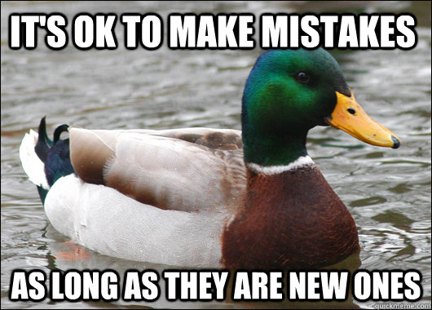

Slide 36
recap
Code smells

Slide 37
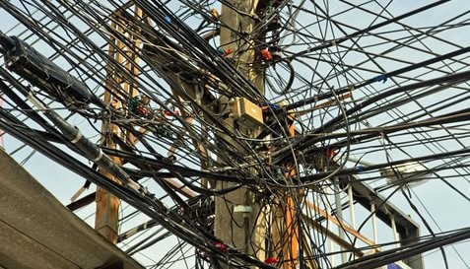
Change Preventers

Slide 38
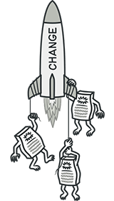
Change Preventers
(Preventers الْمَوَانِع .)
These smells mean that if you need to change something in one place in your code, you have to make many changes in other places too.

Slide 39

Divergent Change

Slide 40
Divergent change

Slide 41
Divergent Change
Divergent مُتَشَعِّبٌ .

Slide 42

Marvel

Slide 43

Our hero today
Iron man

Slide 44

class Hero {
int stamina;
int health;
int arm_Health;
int arm_power;
string arm_shield;
void defense(String part,Int damage){
if(part==arm){
if(arm_Health- damage!=0){
arm_Health-=damage;
}
}
}
}
void attack(String part ,Int damage){
if(part==arm){
arm_powr+=damage*0.2;
}
}

Slide 45
Divergent Change
(Divergent مُتَشَعِّبٌ .)
Divergent Change is when many changes are made to a single class.
“methods”

Slide 46
Divergent Change
Why this happens
poor program structure or "copypasta programming”.

Slide 47

Divergent Change
Treatment
Split up the behavior of the class via Extract Class
Extract Class !!!

Slide 48
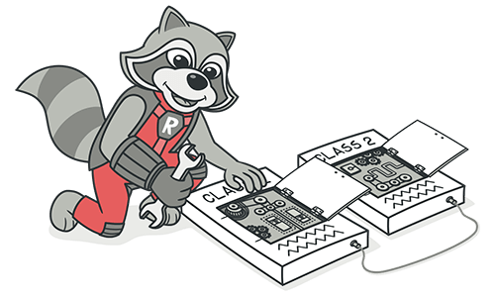
Divergent Change
What is Extract class
When one class does the work of two.
Our example :
Hero :health ,arm_Health,arm_power
Let’s fix
Notes:
Guess what is inline class

Slide 49
class Hero {
int stamina
int health;
Arm arm;
void call_defense(String part,Int damage)
{
if(part==arm)arm.defense(damage);
}
void call_attack(String part,Int damaage)
{
if(part==arm)arm.attack(damage);
}
}

Slide 50
class Arm {
int arm_Health;
int arm_power;
string arm_shield; void defense(Int damage){
if(arm_Health- damage!=0){
arm_Health-=damage;
}
}
void attack(Int damage){
arm_powr+=damage*0.2;
}
}

Slide 51
What happened !!
Combine using extract class (Arm)
Move fields (fields of Arm)
(3) Move methods (defense and attack)

Slide 52

Divergent Change
Treatment
(1) Split up the behavior of the class via Extract Class
Case of related class ??
If classes have same behavior combine them using inheritance throw
(Extract Superclass and
Extract Subclass)

Slide 53
(problem)
Class employee
{
Int calac_year_profit(){}
String get_name(){}
Int get_id(){}
}
Class depatment
{
int calac_year_profit(){}
String get_name(){}
Int get_head_count(){}
}

Slide 54
(Extract Superclass)
abstract class part{
abstract int calac_year_profit();
abstract string get_name();
}
Class employee extends part
{
Int calac_year_profit(){}
String get_name(){}
Int get_id(){}
}
Class department extends part
{
int calac_year_profit(){}
String get_name(){}
Int get_head_count(){}
}

Slide 55
(problem)
class Registration
{
string non_ registration_action {}
int registration_total {}
string notes_not_registration {}
string description_of_ registration {}
DateTime registration_date {}
}

Slide 56
(Extract Subclass)
class Registration
{
int registration_total {}
string description_of_ registration {}
DateTime registration_date {}
}
class non_ registration extents Registration
{
string non_ registration_action {}
string notes_non_registration {}
}

Slide 57
Divergent Change
Treatment
(1) Extract Class
(2) Extract Superclass
(3) Extract Subclass

Slide 58

Divergent Change
Benefits
(+) Improves code organization.
(+) Reduces code duplication.
(+) Simplifies support. (+) apply Single Responsibility Principle
Notes:
ملبس للي يقول الديزين باترن اللي بيحققه

Slide 59
Divergent Change
shotgun surgery

Slide 60

Shotgun Surgery

Slide 61
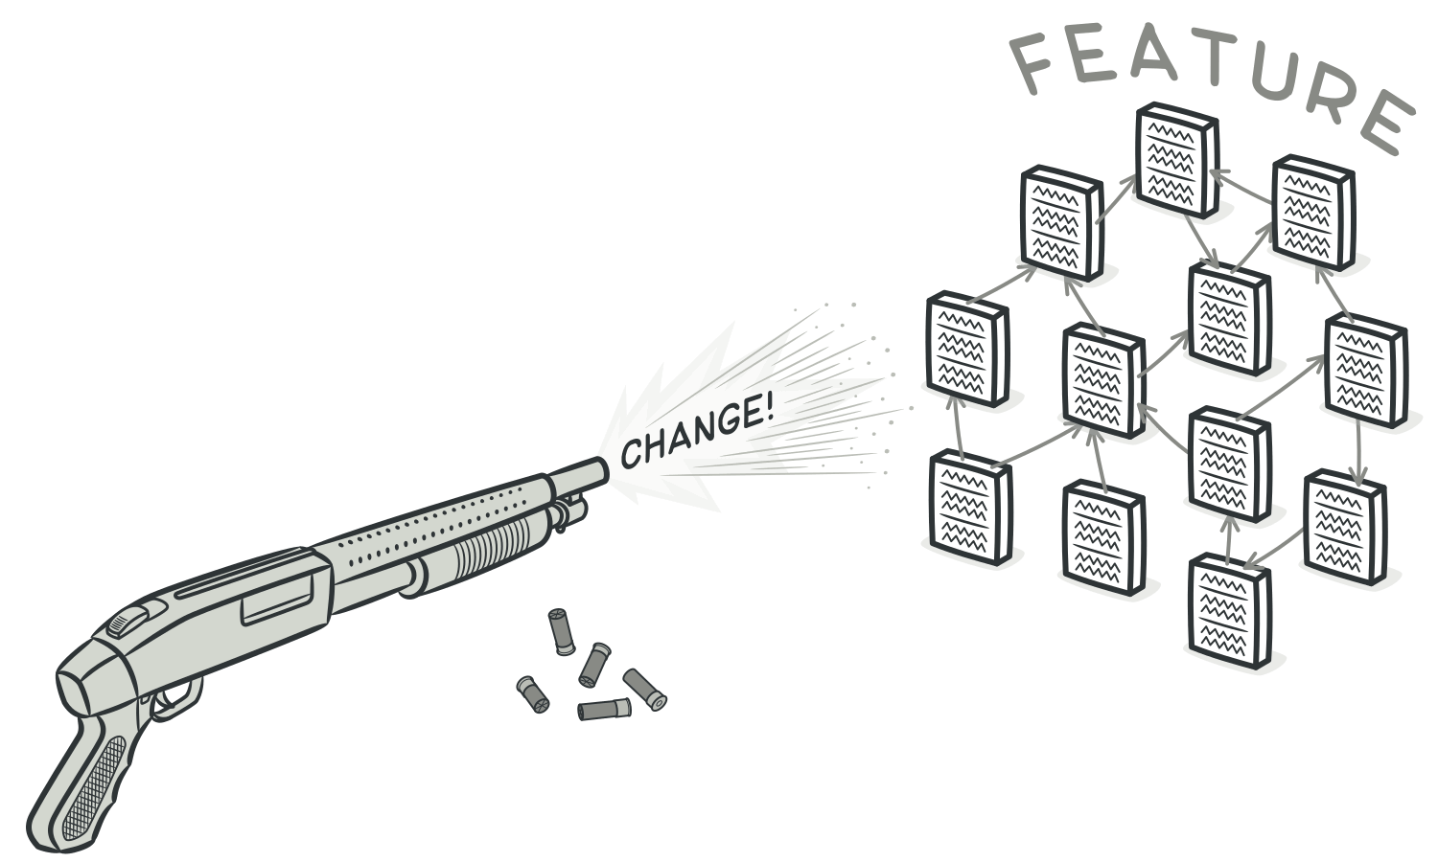
Shotgun Surgery
Shotgun بُنْدُقِيَّة .

Slide 62
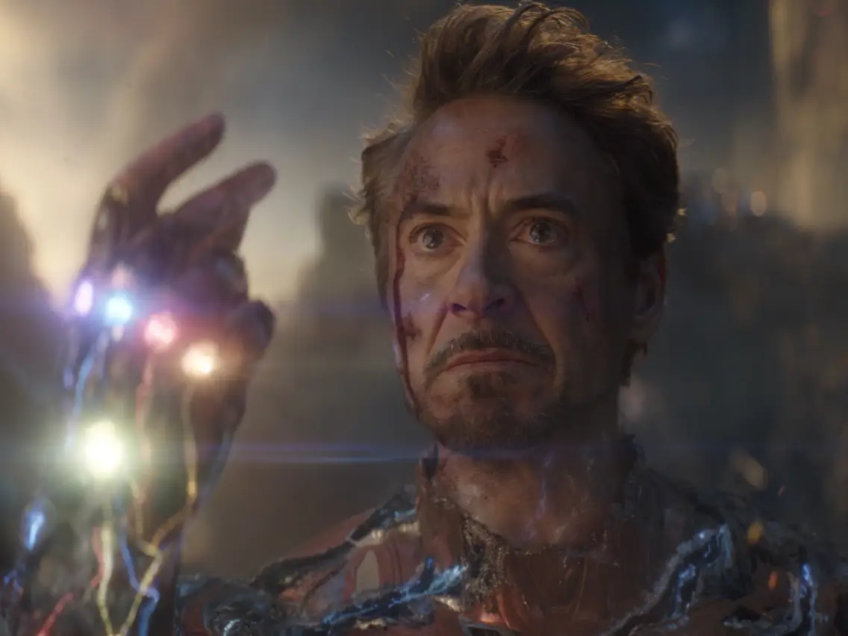
Welcome back
Iron man

Slide 63
class Hero {
First_finger f1;
Second_finger f2;
Third_finger f3;
Forth_finger f4;
Fifth_finger f5;
}
class Second_finger {}
class Third_finger {}
class Forth_finger {}
class Fifth_finger {}
class First_finger {}

Slide 64
Shotgun Surgery
(Shotgun بُنْدُقِيَّة .)
Shotgun Surgery refers to when a single change is made to multiple classes simultaneously.

Slide 65
Shotgun Surgery
Why this happens
A single responsibility has been split up among a large number of classes. This can happen after overusing of Divergent Change.
Notes:
سؤال بسبب انهي ديزين باترن وهل له علاقه باللي قبله ولو اه يبقي اسمه ايه انهي نوع اكستراكت ولا انلين

Slide 66
Shotgun Surgery
Treatment
Use Move Method and Move Field between class.
What if there is nothing in common and nothing to move so use make new class

Slide 67
Shotgun Surgery
What is Inline class
A class does almost nothing
Notes:
Guess what is inline class

Slide 68

class Hero {
First_hand f1;
Second_hand f2;
}
class first_hand {}
class second_hand {}

Slide 69
Shotgun surgery
Benefits
(+) Better organization.
(+) Less code duplication.
(+) Easier maintenance

Slide 70
Divergent Change
Parallel Inheritance Hierarchies
shotgun surgery

Slide 71

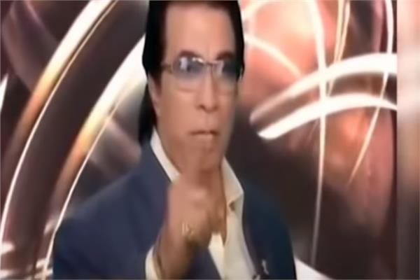

Slide 72
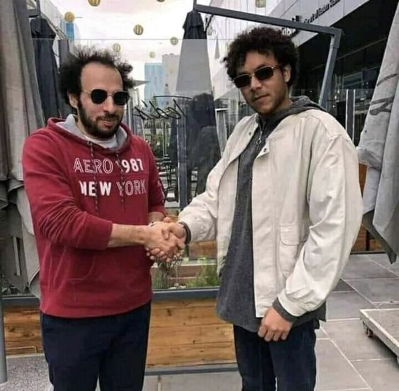
Youtube
What is Code Smell? - YouTube
(354) [Webinar] Identifying code smells – YouTube
Definition
Divergent Change (refactoring.guru)
Shotgun Surgery (refactoring.guru)

Slide 73

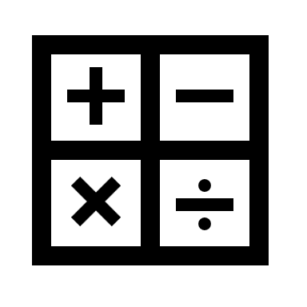
Recap
SOLID
S
Single Responsibility Principle

Slide 74

Recap
SOLID
Single Responsibility Principle
O
Open-Closed Principle (OCP)
shape
(+)Get area
override
Notes:
Oprn for extension and closed to modification.”

Slide 75



Recap
SOLID
Single Responsibility
Open-Closed Principle (OCP)
L
Liskov Substitution Principle
الِاسْتِبْدَال .
Bird
(+)Eat
Flyable bird
(+)fly
Penguin
Eagle

Slide 76



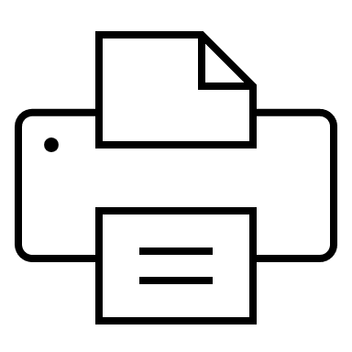

Recap
SOLID
Single Responsibility
Open-Closed Principle (OCP)
Liskov Substitution Principle
I
Interface Segregation Principle
فصل .
Economic printer
Super printer

Slide 77
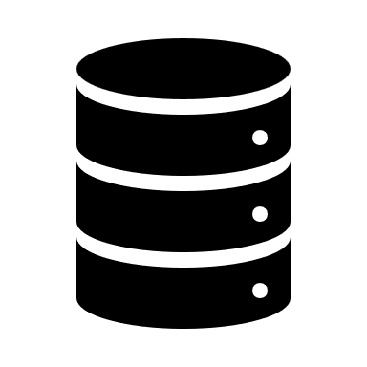

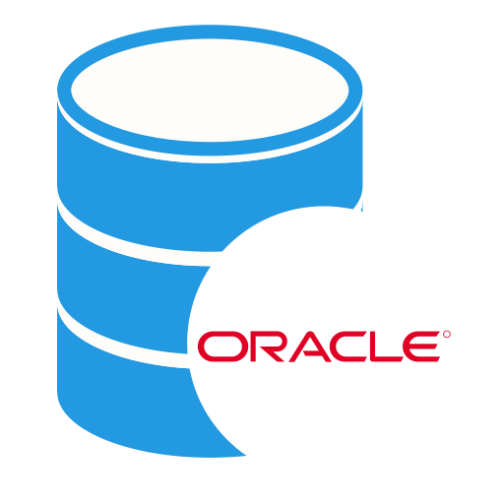
Recap
SOLID
Single Responsibility
Open-Closed Principle (OCP)
Liskov Substitution Principle
Interface Segregation Principle
D
Dependency Inversion Principle
الاعتمادية
.
(+)connect (+)disconnect
DB

Slide 78
Recap
SOLID
Single Responsibility
Open-Closed Principle (OCP)
Liskov Substitution Principle
Interface Segregation Principle
Dependency Inversion Principle

Slide 79

Before saying goodbye to code smells
Let’s have a look about properties of oop code smells

Slide 80
Effect of not using divergent change
Fragility
هَشاشَة
The software breaks in many places due to a single change.

Slide 81
properties of oop code smells
(1) Rigidity
صَلَابَةٌ.
The software is difficult to change. A small change causes subsequent changes.
Dependency Inversion Principle

Slide 82
properties of oop code smells
(3) Immobility الْجُمُود
You cannot reuse parts of the code in other projects because of involved
risks and high effort.
Interface Segregation Principle

Slide 83
(4)Needless Complexity تعقيد
The design contains elements that are currently not useful so extending
and changing the code results in higher effort than necessary.
Wrong use of design pattern

Slide 84
(5)Needless Repetition تكرار
Code contains exact code duplications or design duplicates .
Shotgun surgery

Slide 85
(6) Opacity العتمة
The code is hard to understand any change takes additional time.
Single Responsibility Principle
Liskov Substitution Principle

